Slide 1
Data Types & Variables
Lecturer: Nadia Binte Asif

Slide 2
Data Types
Used to declare variables and functions
Type of variable defines how much mem. it occupies in storage
How bit pattern is interpreted
Common types are: Integer, Char, Float & Double

Slide 3
Type | Storage | Value Range
char | 1 byte | -128 to 127 or 0 to 255
unsigned char [only pos numbers] | 1 byte | 0 to 255
signed char [ both] | 1 byte | -128 to 127
int | 2 or 4 bytes | -32,768 to 32,767 or -2,147,483,648 to 2,147,483,647
unsigned int | 2 or 4 bytes | 0 to 65,535 or 0 to 4,294,967,295
short | 2 bytes | -32,768 to 32,767
unsigned short | 2 bytes | 0 to 65,535
long | 8 bytes or (4bytes for 32 bit OS) | -9223372036854775808 to 9223372036854775807
unsigned long | 8 bytes | 0 to 18446744073709551615

Slide 4
Type | Storage | Value Range | Precision
float | 4 byte | 1.2E-38 to 3.4E+38 | 6 decimal places
double | 8 byte | 2.3E-308 to 1.7E+308 | 15 decimal places
long double | 10 byte | 3.4E-4932 to 1.1E+4932 | 19 decimal places
void | Defines absence of type
Primitive data types – int, float, double, char
Aggregate OR derived data types – Arrays come under this category – Arrays can contain collection of int or float or char or double data
User defined data types – Structures and enum fall under this category.

Slide 5
What is variable?
An entity that may vary during program execution is called a variable
C works by keeping everything in the RAM → Location → Names
Every information has its own type → Data types
A location can only store that type of data

Slide 6
Variable Declaration
When you declare a variable, you are telling the compiler the kind of value the variable may hold (its type)
You cannot change the type of value a variable can hold once declared (well, pretty much anyway)
In fact, everything needs a type in C and it must be declared before use!
Syntax
<variable_type> <variable_name>;
Ex1: int length;
length = 5;
Ex2: int num = 1 ;

Slide 7
Format Specifiers
To display values of variables of different types
Used in Printf and Scanf functions
Symbol:%

Slide 8
Format Specifiers | Type of Output
%d or %i | A decimal integer or signed integer
%c | Signed character
%f | Signed float
%e | A floating-point number
%s | A string or sequence of character
%lf | double
%Lf | Long double
%o %u | Octal integer Short unsigned integer
%ld | Long decimal integer
%x | Hexadecimal integer
%p | Print memory address in the hexadecimal form

Slide 9
Writing your first program
Problem: Add two numbers given by user and print the result

Slide 10
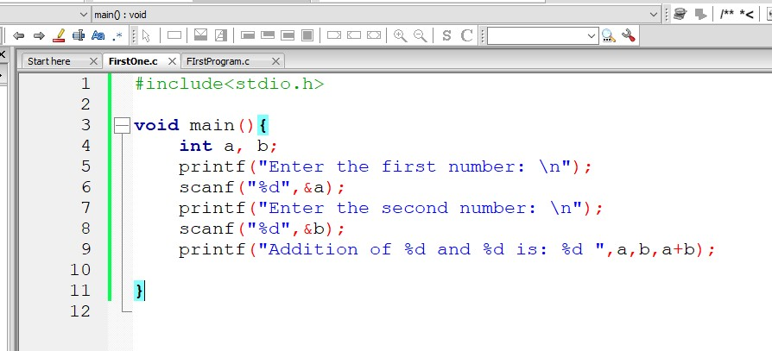
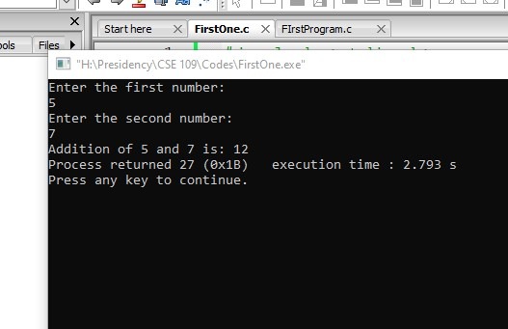

Slide 11
Writing your first program
Problem: Perform the following operation: A+B-C/D

Slide 12
Operators
Arithmetic Ops: +,-, *,/, ++, --, %
Conditional: &&, ||, !, ==
Assignment: =

Slide 13
Problems
Write a C program that takes two float numbers from users and prints them as outputs.
How to take character inputs? How to print them?
What is the purpose of modulus operator? Explain with example.
How to print out the precision of a double variable?

